Slide 1
Introduction to PHP

Slide 2
Introduction to PHP
PHP is a server-side and general-purpose scripting language that is especially suitable for web development.
PHP originally stood for Personal Home Page. However, now, it stands for Hypertext Preprocessor. It’s a recursive acronym because the first word itself is also an acronym.
PHP was created by Rasmus Lerdorf in 1994. It’s currently maintained by the PHP Development Team.

Slide 3
PHP is a server-side language
When you open a website on your web browser, for example, https://www.abc.net
The web browser sends an HTTP request to a web server where abc.net locates. The web server receives the request and responds with an HTML document.
In this example, the web browser is a client while the web server is the server. The client requests for a page, and the server serves the request.
PHP runs on the web server, processes the request, and returns the HTML document.

Slide 4
PHP is a general-purpose language
When it comes to the purpose of the programming languages, there are two main types: domain-specific and general-purpose languages.
The domain-specific languages are used within specific application domains. For example, SQL is a domain-specific language. It’s used mainly for querying data from relational databases. And SQL cannot be used for other purposes.
On the other hand, PHP is a general-purpose language because PHP can develop various applications.

Slide 5
PHP is a cross-platform language
PHP can run on all major operating systems, including Linux, Windows, and macOS.
You can use PHP with all leading web servers such as Nginx, OpenBSD, and Apache. Some cloud environments also support PHP like Microsoft Azure and Amazon AWS.
PHP is quite flexible. It’s not just limited to processing HTML. PHP has built-in support for generating PDF, GIF, JPEG, and PNG images.
One notable feature of PHP is that it supports many databases, including MySQL, PostgreSQL, MS SQL, db2, Oracle Database, and MongoDB.

Slide 6
What can PHP do
PHP has two main applications:
Server-side scripting – PHP is well-suited for developing dynamic websites and web applications.
Command-line scripting – like Python and Perl, you can run PHP script from the command line to perform administrative tasks like sending emails and generating PDF files.

Slide 7
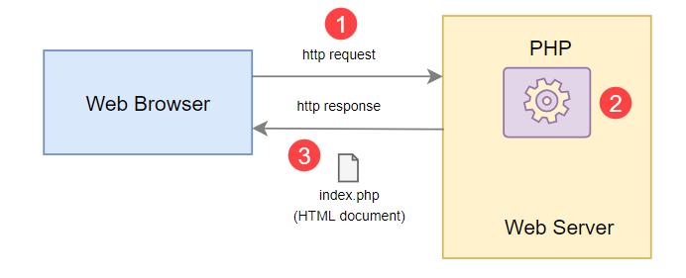
How PHP Works

Slide 8
How PHP Works
First, the web browser sends an HTTP request to the web server, e.g., index.php.
Second, the PHP preprocessor that locates on the web server processes PHP code to generate the HTML document.
Third, the web server sends the HTML document back to the web browser.

Slide 9
Advantages of PHP
Simple – PHP is quite easy to learn and get started.
Fast – PHP websites typically run very fast.
Stable – PHP is stable since it has been in existence for a long time.
Open-source and free – PHP is open source and free. It means that you don’t have to pay a license fee to use PHP to develop software products.
Community support – PHP has an active online community that helps you whenever you face an issue.

Slide 10
PHP Syntax
You’ll learn basic PHP syntax, including case sensitivity, statements, and whitespaces.
As a programming language, PHP has a set of rules that governs how you write programs.

Slide 11
PHP code
Like HTML, you need to have the opening tag to start PHP code: <?php
If you mix PHP code with HTML, you need to have the enclosing tag: ?>
Example:
<h1>
<?php
echo 'PHP Syntax’;
?>
</h1>

Slide 12
However, if a file contains only PHP code, the enclosing tag is optional:
<?php
echo 'PHP Syntax';

Slide 13
Case sensitivity
PHP is partially case-sensitive. Knowing what are case sensitive and what is not is very important to avoid syntax errors.
If you have a function such as count, you can use it as COUNT. It would work properly.
The following are case-insensitive in PHP:
PHP constructs such as if, if-else, if-elseif, switch, while, do-while, etc.
Keywords such as true and false.
User-defined function & class names.
On the other hand, variables are case-sensitive. e.g., $message and $MESSAGE are different variables.

Slide 14
Statements in PHP
A PHP script typically consists of one or more statements. A statement is a code that does something, e.g., assigning a value to a variable and calling a function.
A statement always ends with a semicolon (;). The following shows a statement that assigns a literal string to the $message variable:
$message = "Hello";

Slide 15
The above example is a simple statement. PHP also has a compound statement that consists of one or more simple statements. A compound statement uses curly braces to mark a block of code. For example:
if( $is_new_user )
{
send_welcome_email();
}
You don’t need to place the semicolon after the curly brace (}).

Slide 16
The closing tag of a PHP block (?>) automatically implies a semicolon (;). Therefore, you don’t need to place a semicolon in the last statement in a PHP block.
For example:
<?php
echo $name
?>

Slide 17
In this example, the statement echo $name doesn’t need a semicolon. However, using a semicolon for the last statement in a block should work fine.
For example:
<?php
echo $name;
?>

Slide 18
Whitespace & line breaks
In most cases, whitespace and line breaks don’t have special meaning in PHP. Therefore, you can place a statement in one line or span it across multiple lines.
For example, the following code snippets are equivalent:
login( $username, $password );
login(
$username,
$password
);

Slide 19
Summary
PHP is partially case-sensitive.
PHP constructs, function names, class names are case-insensitive, whereas variables are case-sensitive.
A statement ends with a semicolon (;).
Whitespace and line breaks don’t matter in PHP; do leverage them to make the code more readable.

